Slide 1
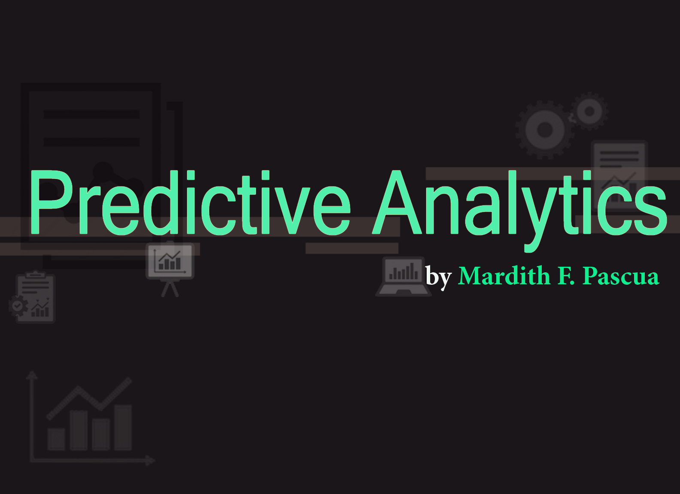

Slide 2

Predictive Analytics
A data analysis that uses data mining and statistical modeling of historical data to understand possible outcomes for different subject such as business needs, status, and strategies. It helps to determine what could happen in the future.

Slide 3

Predictive Analytics
vs.
Descriptive Analytics

Slide 4
Predictive Analytics
Use data to predict future outcomes
Descriptive Analytics
Use data to describe what is happening

Slide 5
Predictive Analytics
Analyze data to identify what will happen in the future
Descriptive Analytics
Analyze data to summarize what happened / what is happening

Slide 6



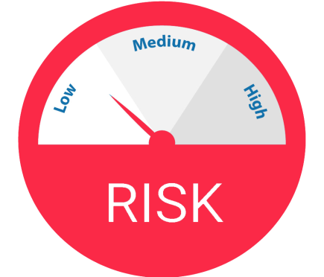
Predictive Analytics Application Areas
Business Workforce and Sales Revenue
Customer Churn Rate
Business Risk Management

Slide 7

Business Workforce and Sales Revenue
It can help to determine the trends of the business population whether they will need more people for the business operations to provide more sales and increase the business’s revenue.

Slide 8

Customer Churn Rate
Predictive analytics can be used to determine customer’s status when they will end their subscription or patronage in the company’s product. It will also help to identify the possible causes why the customer will leave before it actually happen.

Slide 9
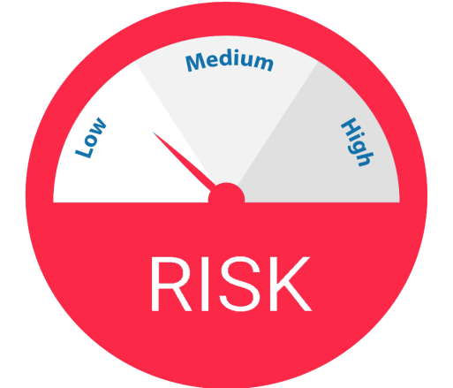
Business Risk Management
Predictive analytics can also help to build a decision support system that can help analyze possible problems that can lead to business risk if they will invest to different stock market.

Slide 10




PEO LNUS Analytical Role Team
Using Predictive Analytics
Future Quantity of Pubs
Forecast Schedule and Revenue
Customer who uses Lexis Advance and eBook product
Outsourcing new process from
US to PEO LNUS Analytical Team

Slide 11

Future Quantity of Pubs
By analyzing the current number
of publications that we have for the year, the team can identify the number of publication that will turn over to team from US for next year.

Slide 12

Forecast Schedule and Revenue
It helps to prevent future revenue loss
for LNUS Analytical Team; we can identify how much revenue the team could loss if a certain publication will not be deliver on-time through analyzing the target revenue and the cost of each publication.

Slide 13

Customer who uses Lexis Advance and eBook product
By analyzing the customer’s feedback or
concerns, predictive analytics can be used to identify whose customers will retain their subscription to our products and which customer will cancel their subscription and when they will end their subscription.

Slide 14

Outsourcing new process from
US to PEO LNUS Analytical Team
Studying the LNUS Analytical
Team current performance, predictive analytics can be used to determine if the team could effectively handle new processes from US in the future.

Slide 15
THE END

